Slide 1
Rural Plastic and Reconstructive Surgery: What it has given and what comes next?
Dr Robert Toma, Plastic & Reconstructive Surgeon

Slide 2
Disclosures: None

Slide 3
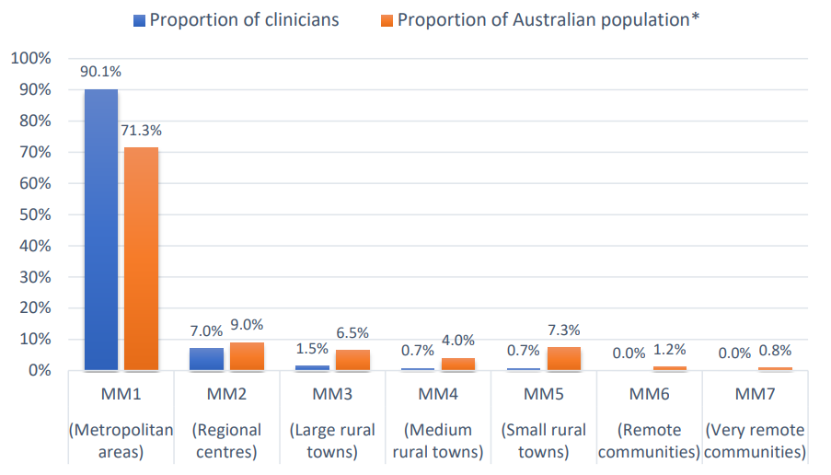
Rural Plastic and Reconstructive Surgery Service
What are the barriers?
Small number of rural plastic and reconstructive surgeons (2.9% plastic Surgeons work in MM3-7, for 19.8% of the Australian population¹)
Work usually performed by plastic and reconstructive surgeons is unfamiliar or misunderstood by community and heath administrators
Lack of funding for plastic and reconstructive services
Geographical for both surgeons and patients
¹Guide to Establishing a Regional or Rural Plastic & Reconstructive Surgery Service, Australian Society of Plastic Surgeons (ASPS)
Notes:
Recommended rate of plastic surgeons per capita is 1 in 57,000
North coast NSW is 1 in 177,000
Perth north 1 in 25,000

Slide 4
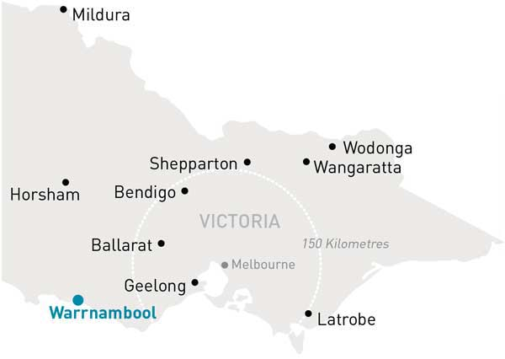
Warrnambool Plastic and Reconstructive Surgery (WPRS)
How it Began
Established in 2012
Located in Warrnambool
Single surgeon practice with 4 staff members
4 public and 6 private operating session a month
No registrar
On call 1:1

Slide 5
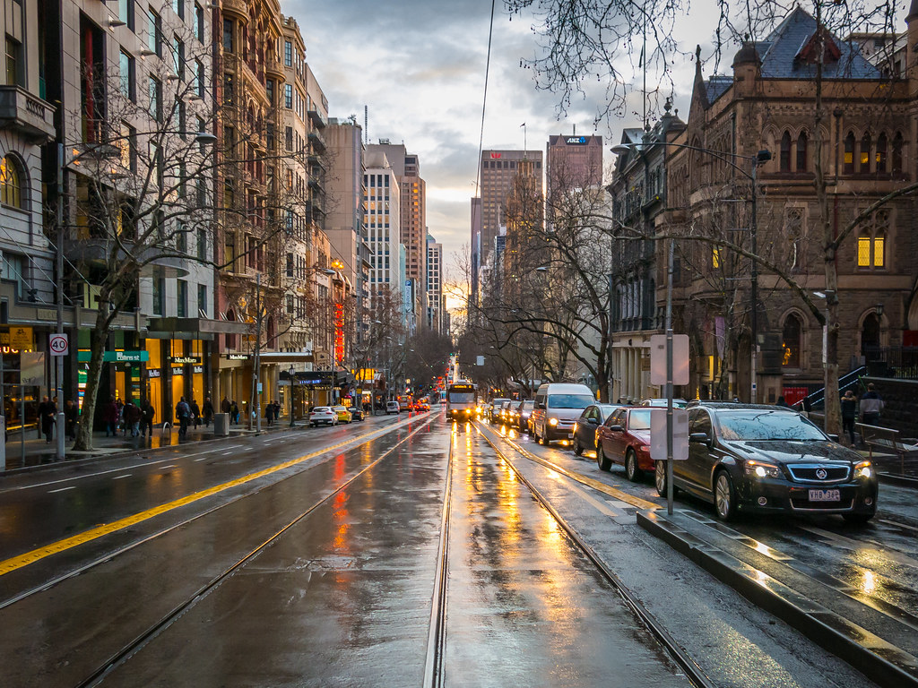
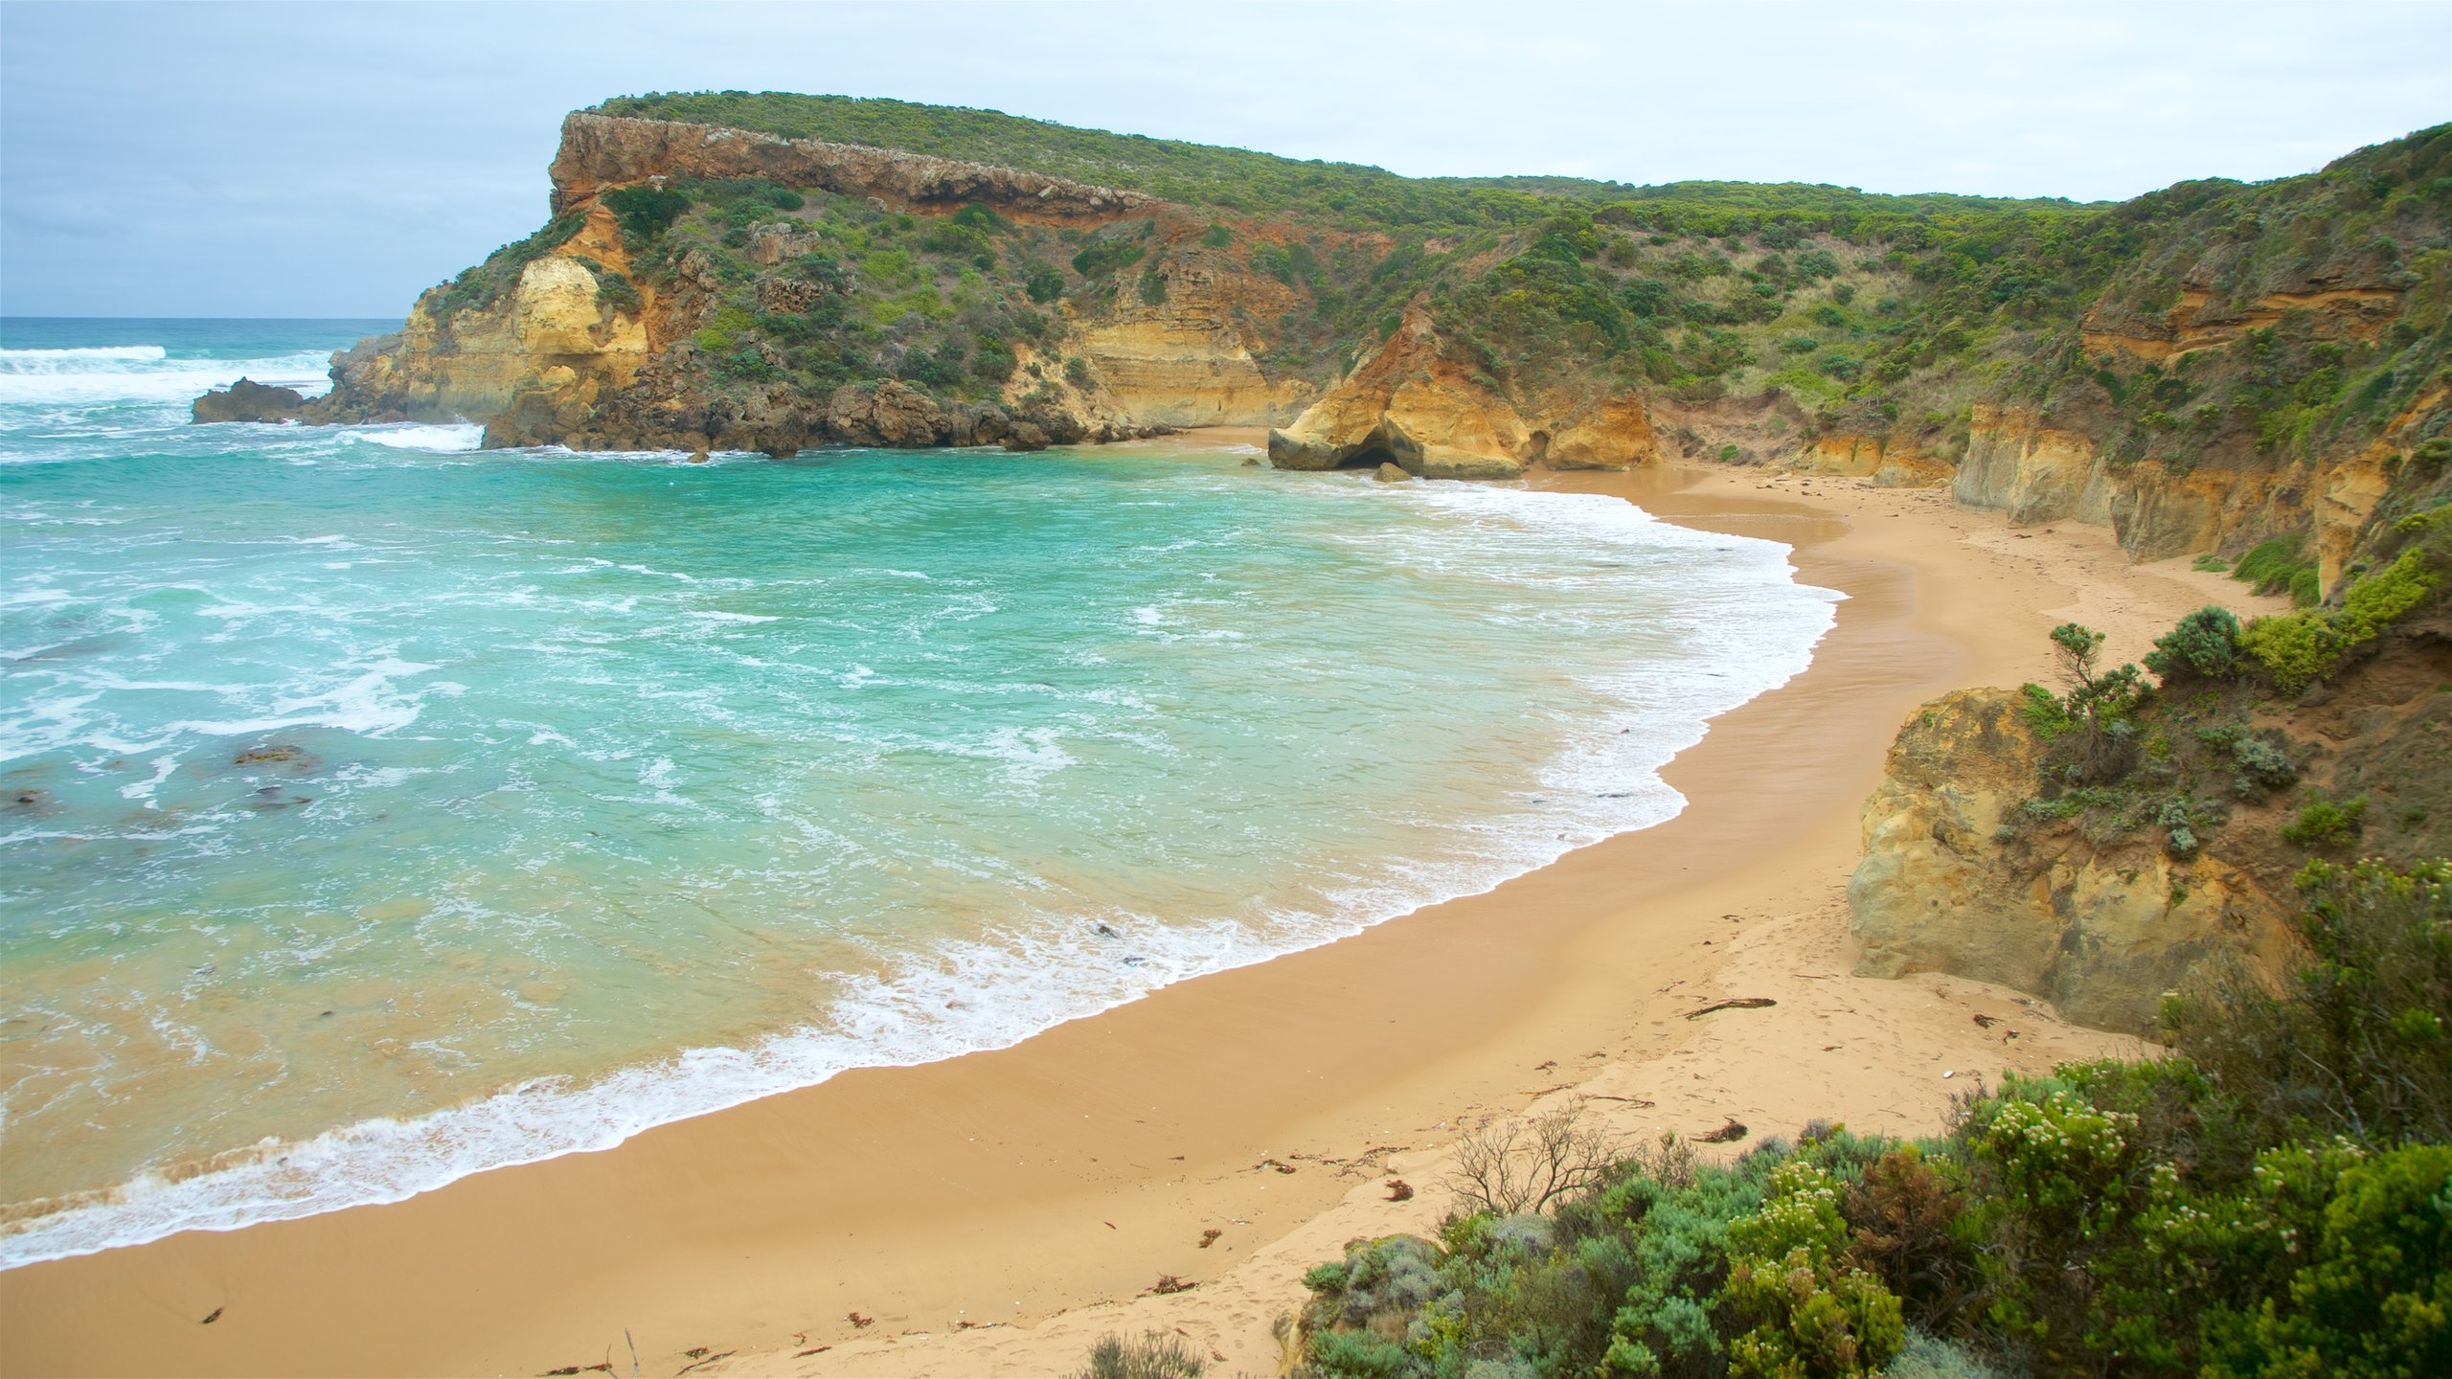
Why?

Slide 6
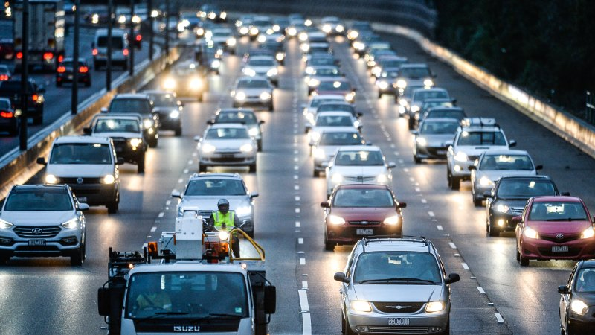
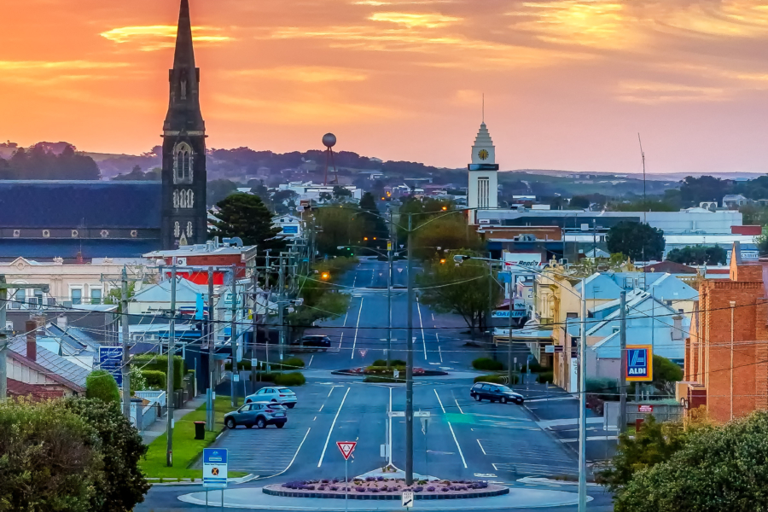

Slide 7
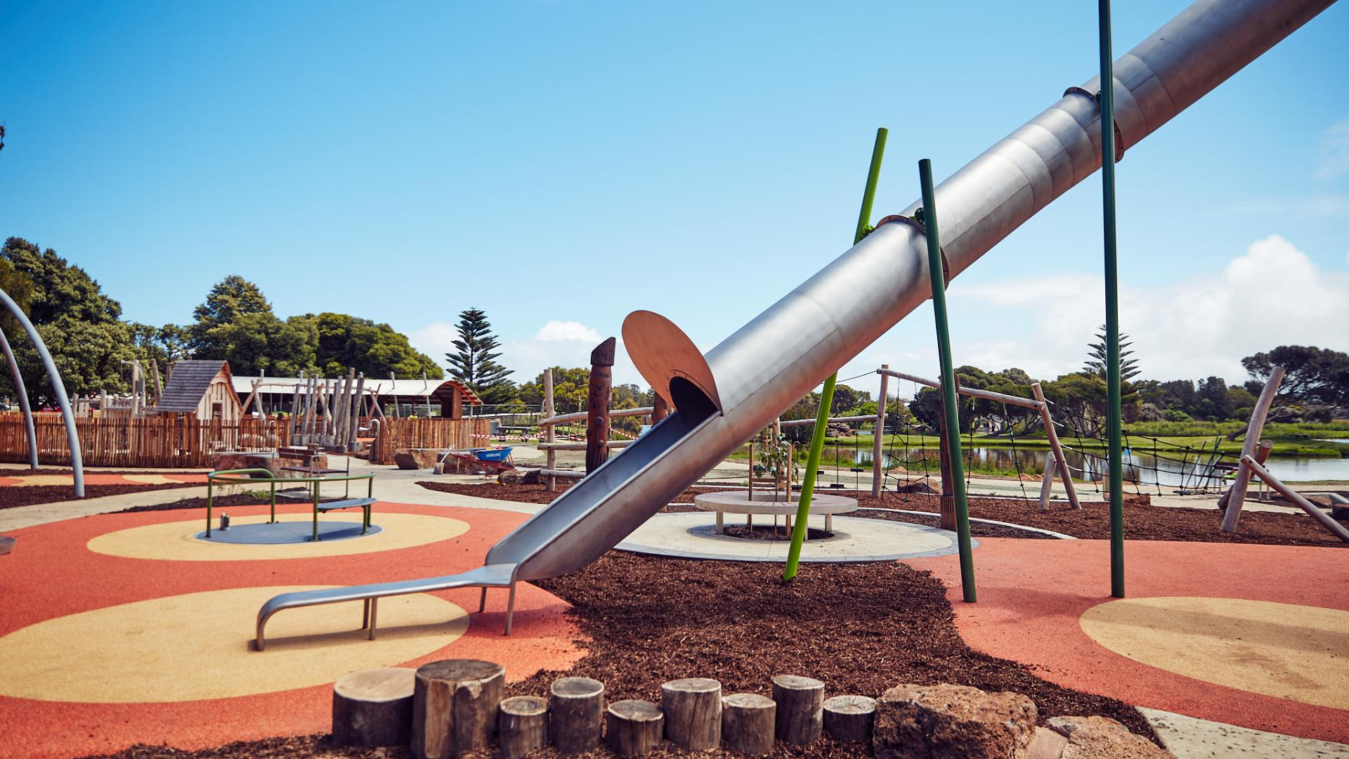
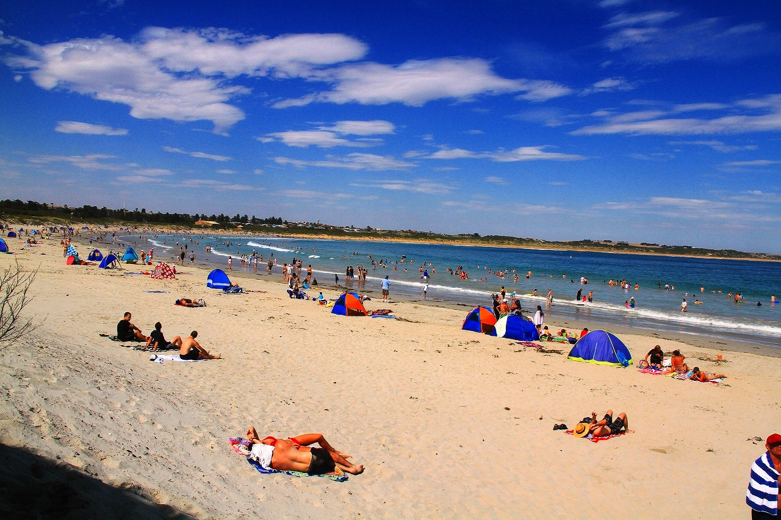

Slide 8
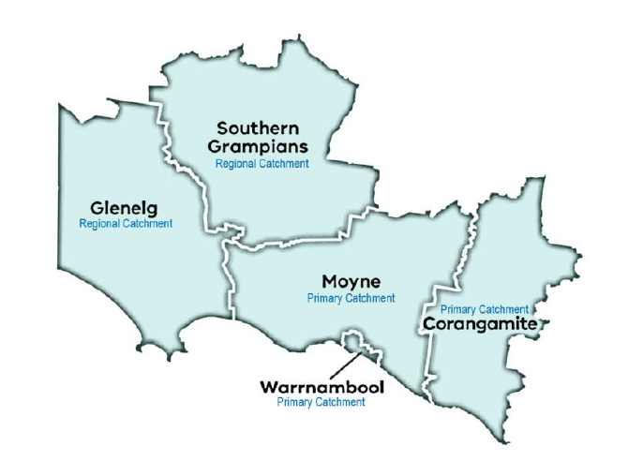
WPRS in 2023
Structure
3 Plastic and Reconstructive Surgeons
Dr Robert Toma – founded WPRS in 2012
Dr John Masters – joined WPRS in 2016
Dr Robert Capstick – joined WPRS in 2021
2 unaccredited registrars
Application submitted for accreditation for SET position to commence 2024
Catchment areas
Elective and emergency services to a population of 151,140 people
Theatre access
Unit performs almost 2,500 operations per year
Public operating at Southwest Healthcare (Warrnambool and Camperdown) and Portland District Health
Private operating at St John of God Warrnambool Hospital
Coordinated care
4 Hand Therapists (Occupational Therapists/Physiotherapist), Specialised wound care nurses, breast reconstruction nurse and WPRS Breast Surgeon and 2 WPRS Dermatologists and registrars
Notes:
Primary catchment: City of Warrnambool and Shires of Moyne and Corangamite
Regional catchment: Shires of Glenelg and Southern Grampians
Unit also captures patients from outside primary and regional catchment areas such as Horsham and South Australia among other locations

Slide 9
Procedures Performed
Skin lesion removal
Cosmetic removal of benign lesion
Skin cancer excision (SCC, BCC, Melanoma)
Skin flap surgery
Sentinel lymph node biopsy
Hand surgery (Elective)
Carpal tunnel release
Removal of ganglions
Removal of cysts and other hand growths
Duypuytren’s contracture release - surgery or collagenase injections (Xiaflex)
Trigger finger release
Osteoarthritis and Rheumatoid arthritis related hand surgery
Ligament rupture repairs
Upper limb nerve decompression
De Quervain’s tenosynovitis release
Tendon transfers for stoke or nerve palsies
Hand surgery (Trauma)
Tendon repairs
Ligament rupture repairs
Nerves and artery repairs
Amputations
Hand fracture fixation
Serious hand infections
Microsurgery
Breast surgery
Breast reconstruction surgery
Correction of inverted nipple
Nipple reconstruction
Correction of congenital breast deformity (Tuberous breast, asymmetry, Poland’s disease)
Gynaecomastia correction (Male breast reduction)
Paediatric surgery
Otoplasty (Bat ear correction)
Removal of congenital skin conditions and vascular lesions
Correction of basic congenital hand conditions (Fusion of finger or extra fingers)
Burns surgery
Management of acute burns
Management of secondary complication of burns (scarring, contracture)
Facial fracture surgery
Correction of nasal deformity
Facial fracture fixation
Miscellaneous procedures
Scar revisions
Fat grafting and correction of contour deformities
Excision of soft tissue tumours
Correction of ectropion and other eyelid effects
Facial nerve palsy corrective procedure
Trauma reconstruction

Slide 10
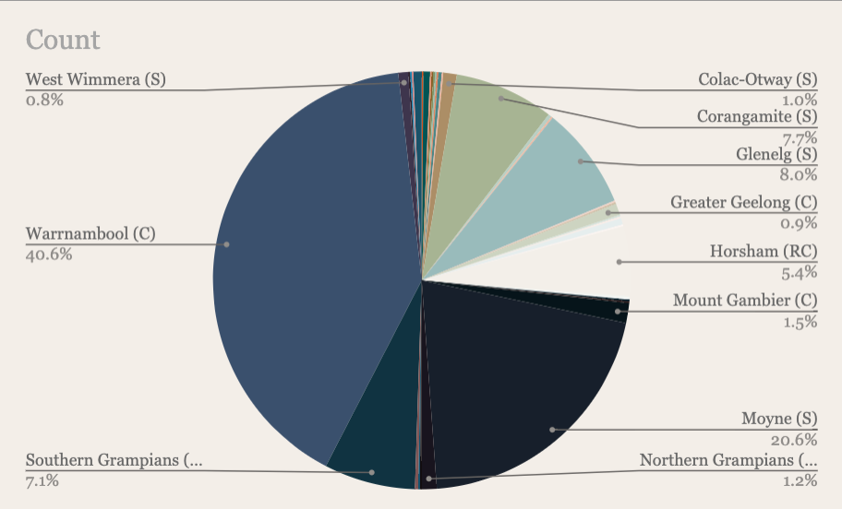
Referral Sources
Plastic and Reconstructive Surgery Audit 2022, WPRS
Notes:
PROCEDURE DATA FOR SWHC
Numbers of main:
Primary:
Warn – 316
Moyne – 160
Corangamite –60
Secondary:
Glenelg – 62
Southern Grampians – 55
Horsham – 42
Mt Gambier - 12

Slide 11
Combined Case Numbers

Slide 12
Combined Case Numbers

Slide 13
Hand Cases

Slide 14
Breast Cases

Slide 15
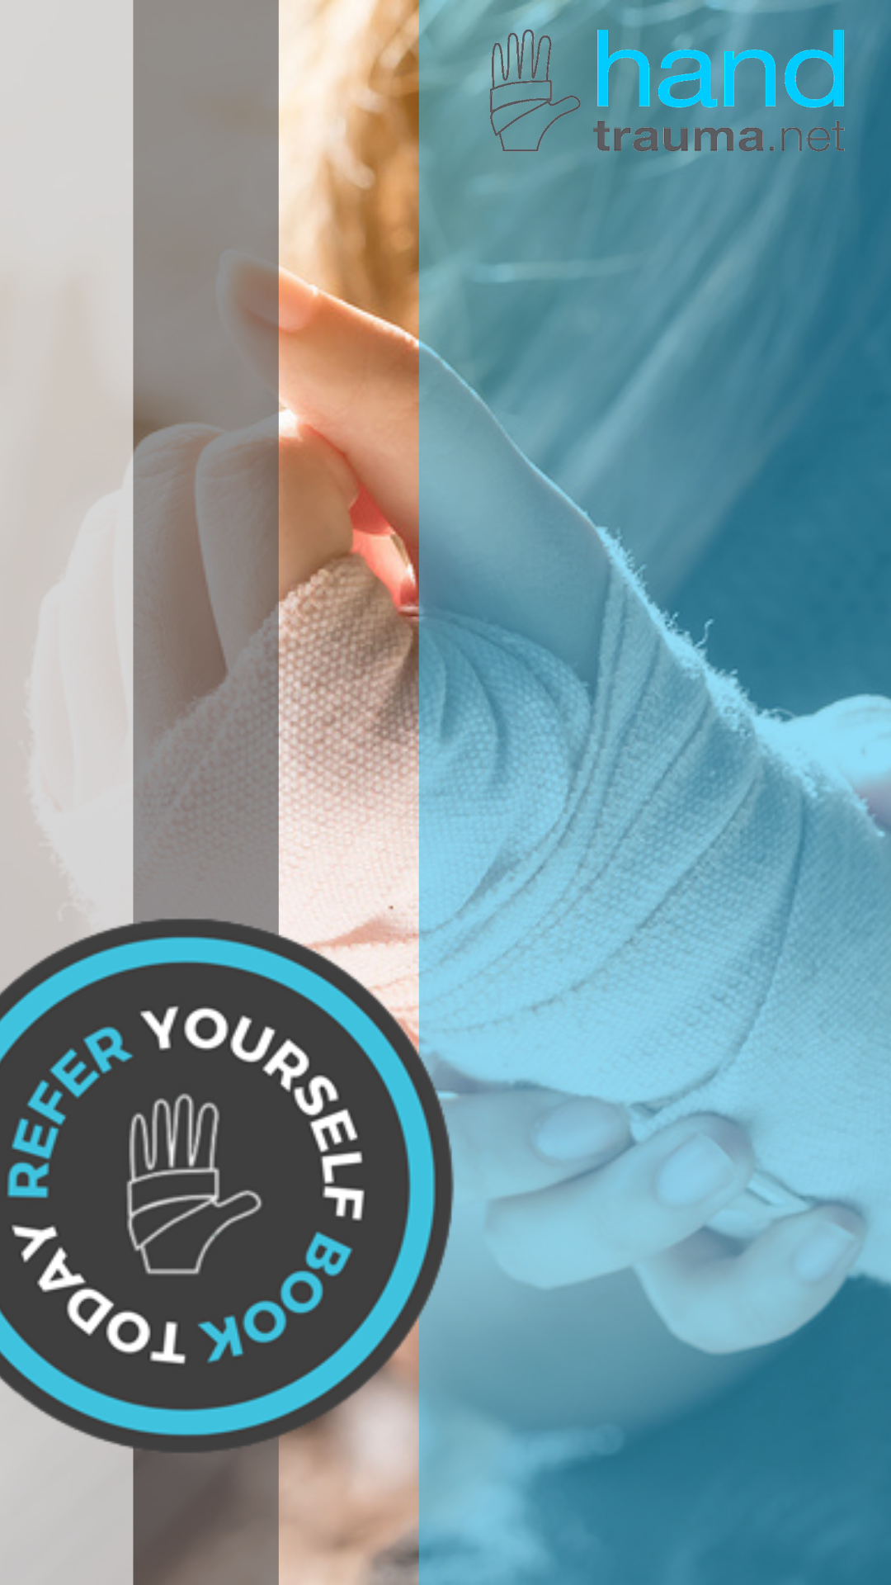
Unit Research into Rural Plastic Surgery
Our unit has undertaken a combination of studies, surveys and audits on travel distance, cost and patient satisfaction
Savings in travel time, cost to patient were compared against nearest metropolitan centre
Findings have led to the development of various initiatives aimed at improving regional access to plastic and reconstructive surgery such as Handtrauma.net and Southwest Breast Clinic

Slide 16
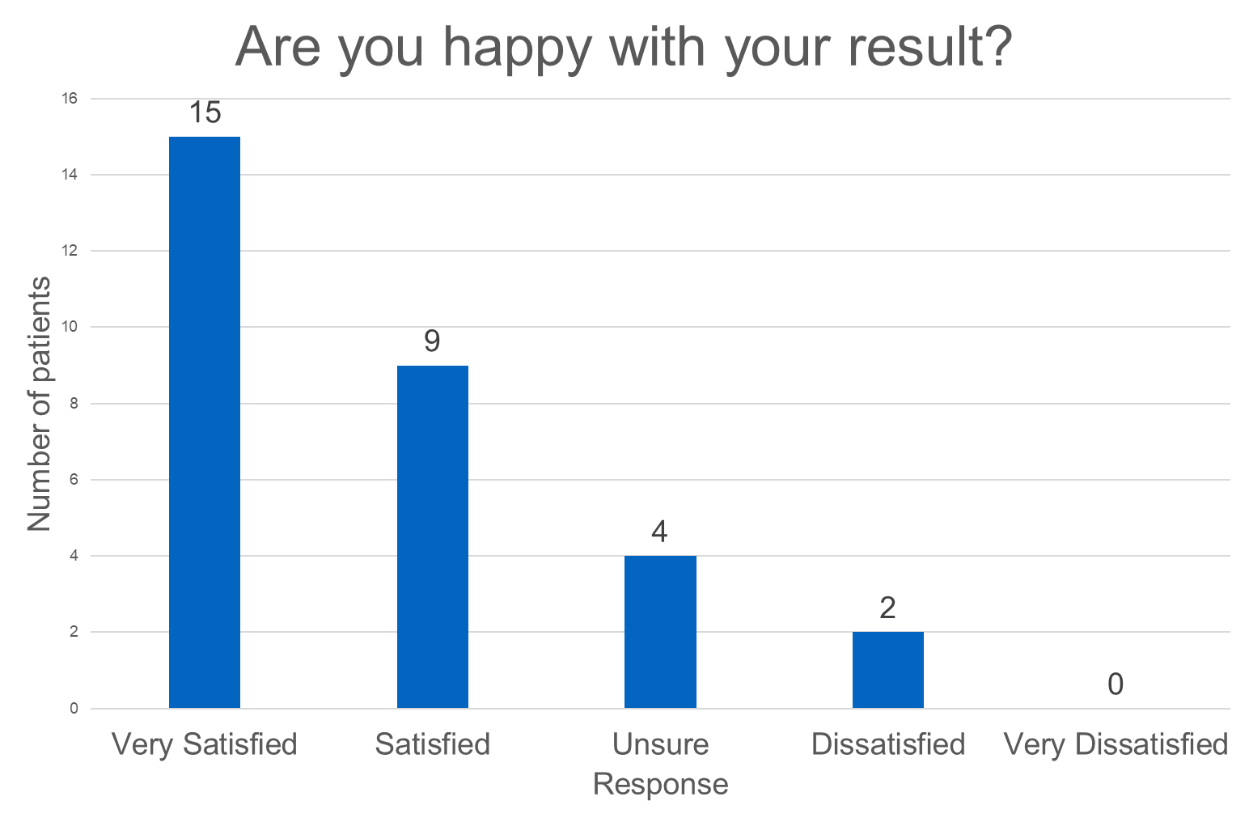
The development of a rural breast reconstruction service: patient reported outcomes and benefits
Preeya GUNNESS¹, Sam HAMILTON¹, Robert CAPSTICK¹, John MASTERS¹, Robert TOMA¹
¹Warrnambool Plastic and Reconstructive Surgery, Warrnambool, Victoria
Published in ANZ Journal of Surgery, 2023
Notes:
Sample
38 participants (8 lost to follow up)
31 immediate reconstructions, with 13 free flaps performed and the remainder undergoing alloplastic reconstructions
29 patients underwent unilateral breast reconstructions, and 9 bilateral reconstruction
Patient satisfaction rates were high, with 80% of participants being satisfied with their result.

Slide 17
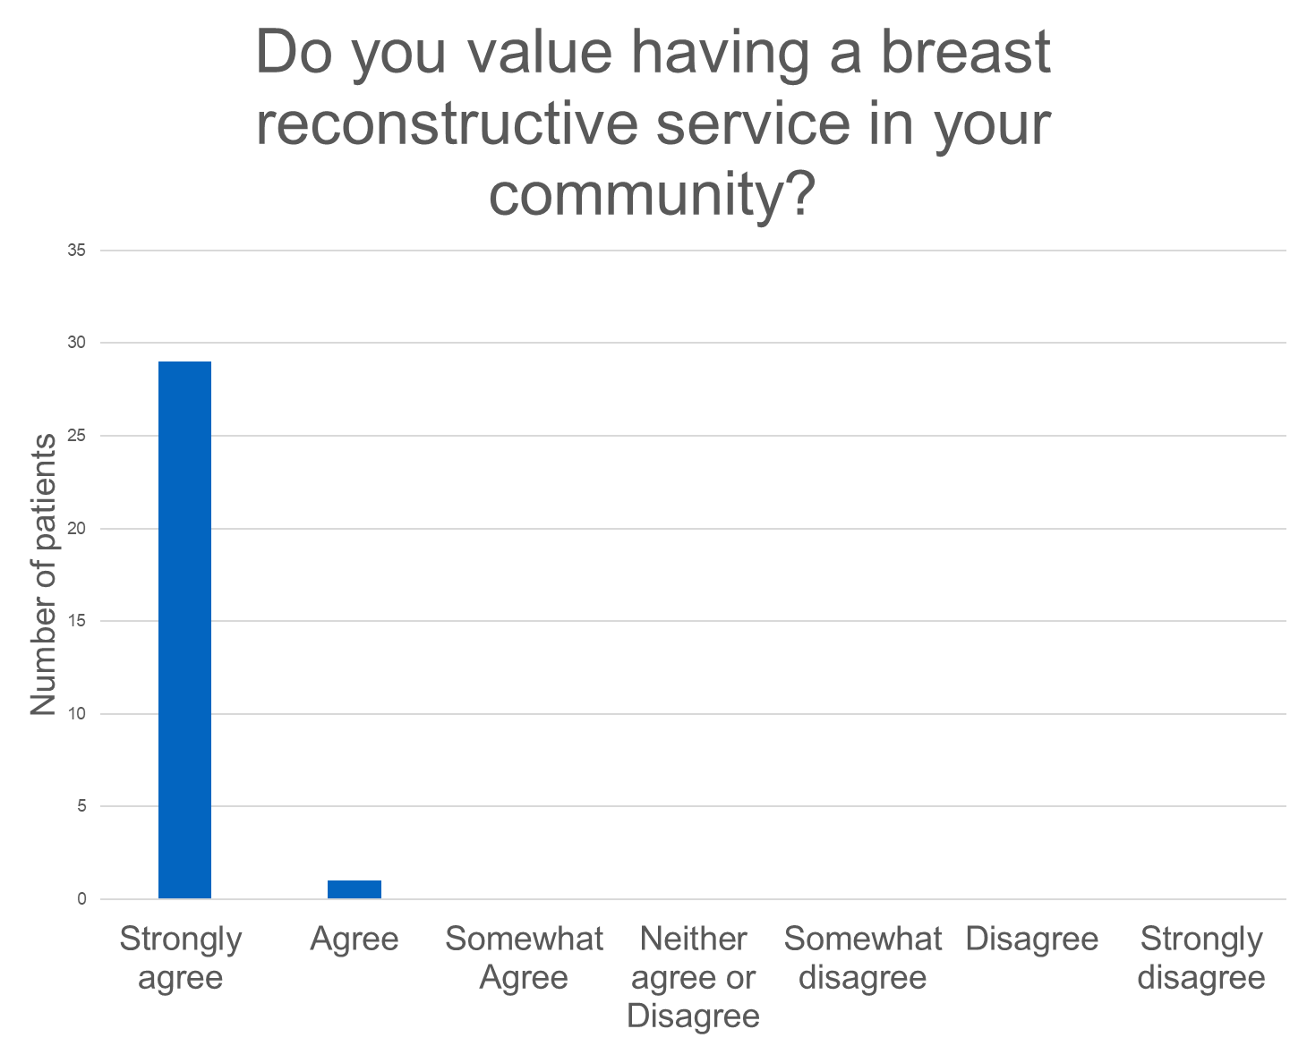
The development of a rural breast reconstruction service: patient reported outcomes and benefits
Preeya GUNNESS¹, Sam HAMILTON¹, Robert CAPSTICK¹, John MASTERS¹, Robert TOMA¹
¹Warrnambool Plastic and Reconstructive Surgery, Warrnambool, Victoria
Published in ANZ Journal of Surgery, 2023
Notes:
97% of participants strongly valued having a breast reconstruction service within their community

Slide 18
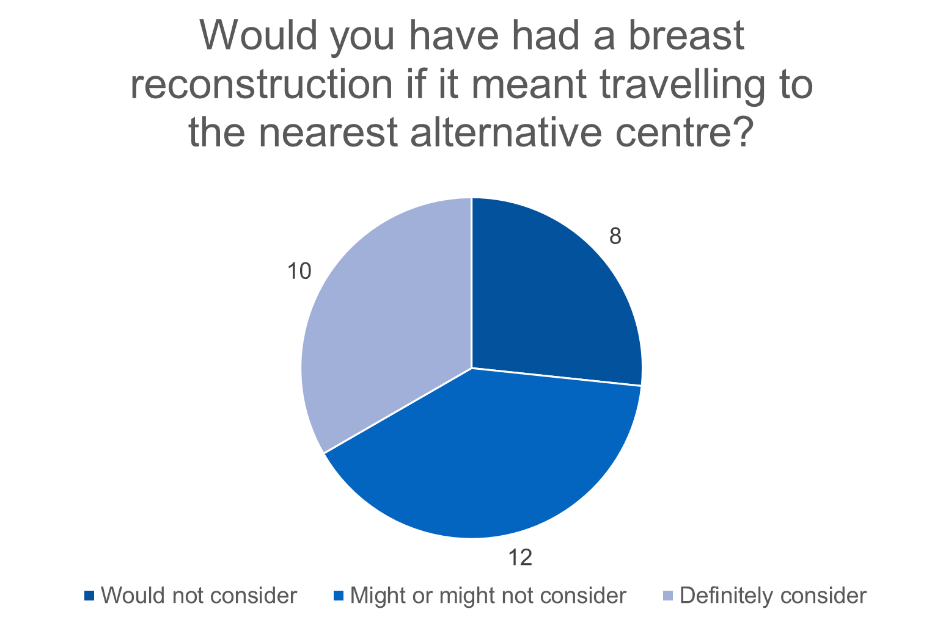
The development of a rural breast reconstruction service: patient reported outcomes and benefits
Preeya GUNNESS¹, Sam HAMILTON¹, Robert CAPSTICK¹, John MASTERS¹, Robert TOMA¹
¹Warrnambool Plastic and Reconstructive Surgery, Warrnambool, Victoria
Published in ANZ Journal of Surgery, 2023
Notes:
The rates of breast reconstruction in Australia are estimated to be as low as 18%, with other studies stating that approximately 50% of women will undergo breast reconstruction if given the opportunity.
In our study only 30% stated they would definitely consider undergoing a reconstruction if required to travel to the closest metropolitan centre.

Slide 19
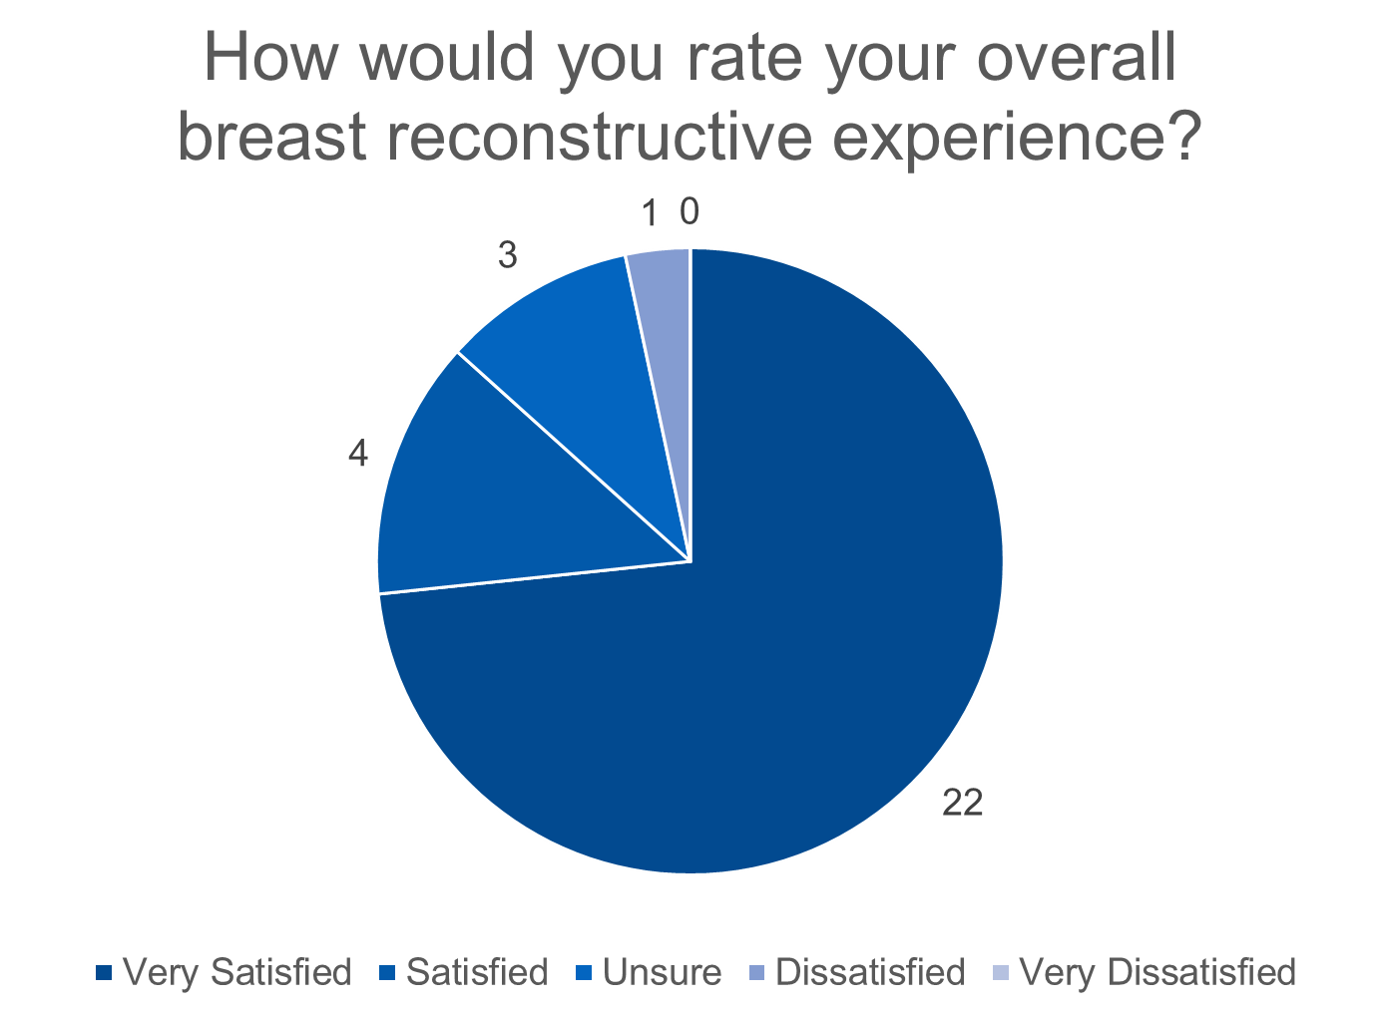
The development of a rural breast reconstruction service: patient reported outcomes and benefits
Preeya GUNNESS¹, Sam HAMILTON¹, Robert CAPSTICK¹, John MASTERS¹, Robert TOMA¹
¹Warrnambool Plastic and Reconstructive Surgery, Warrnambool, Victoria
Published in ANZ Journal of Surgery, 2023
Notes:
86% of participants were satisfied with their breast reconstructive experience.

Slide 20
Economic Benefits of Rural Breast Reconstructive Service
Sam HAMILTON¹, Preeya GUNNESS¹, Robert CAPSTICK¹, John MASTERS¹, Robert TOMA¹
¹Warrnambool Plastic and Reconstructive Surgery, Warrnambool, Victoria
Presented at RACS 91st Annual Scientific Congress
TOTAL COST SAVING TO PATIENTS
Over a 3 year period 64 patients saved was $542,526 in costs associated with travel and accommodation
The average saving for each patient was:
$8,478
Notes:
Rural breast reconstructive services increase accessibility, by decreasing cost and reducing geographic barriers for women who may wish to undergo breast reconstruction after mastectomy.
Retrospective analysis of all patients who presented for breast reconstruction to a rural plastic surgery unit between 2017 and 2021 with 64 patients identified
Distance, cost of travel and productivity loss was calculated for each patient to the rural centre, and the nearest tertiary centre performing breast reconstruction
On average, each patient’s travel requirements reduced by 2,800km by attending a rural breast reconstruction unit compared to the closest metropolitan centre, saving $6,688 on travel costs alone.

Slide 21
Travel cost savings from a regional plastic surgery service: A patient centred evaluation
Toby VINYCOMB¹²³, Hanna JONES², John MASTERS¹²³, Robert TOMA¹²³
Warrnambool Plastic and Reconstructive Surgery, Warrnambool, Victoria
Southwest Healthcare Warrnambool
St John of God Warrnambool Hospital
Presented at RACS 90th Annual Scientific Congress
Retrospective analysis, of 1860 patients, who underwent an operation by the plastic surgery unit at South West Healthcare Warrnambool July 2019 to June 2021 inclusive
Median travel distance was 28 km to our service compared to 259 km to the nearest metropolitan service
Total cost of travel
WPRS: $414,013
Nearest metropolitan service $2,121,833
Total cost saving for the patient
$1,707,740
Notes:
We included 1860 patients in our study
1380 emergency and 480 elective operations.
45 were excluded as they lived outside Victoria.
Closest metropolitan hospital (n): Sunshine Hospital (1854), Royal Melbourne Hospital (10), The Northern Hospital (3).
Metrics
Episode of care: preoperative assessment (elective only), surgery, single postoperative visit.
Travel: distance from patients suburb of residents to Warrnambool or suburb of nearest Melbourne metropolitan public plastic surgery service; cost per km as per Australian Government calculations.¹
Accommodation: average of cheapest room for two people from five closest hotels to metropolitan hospital. Included overnight stay at Warrnambool for patients who lived >200 km from our service.

Slide 22
The economic impact and patient perspectives of providing a rural plastic surgery service
Toby VINYCOMB¹²³, Hanna JONES², John MASTERS¹²³, Robert TOMA¹²³
¹Warrnambool Plastic and Reconstructive Surgery, Warrnambool, Victoria
²Southwest Healthcare Warrnambool
³St John of God Warrnambool Hospital
Presented at RACS 90th Annual Scientific Congress
Cross-sectional study over 4 weeks utilising demographic and operation data and patient survey of 82 participants
51% would prefer to travel 30 mins or more to a regional service than Melbourne
20% would prefer to travel more than 2 hours to regional service than Melbourne
93% felt it was very important to have access to a regional plastic surgery service
.
Notes:
Total costs to patients: $197 vs $1,398 ($245,000 saving over 4 weeks)
204 eligible patients: 82 patients responded (40%)
Median age: 61 years (IQR, 33 to 70)
Elective operations: 30 (37%)
Emergency operations: 52 (43%)
Overnight stays
Preoperative review: 42/66 (64%)
Day procedure: 56/66 (85%)
First post-operative review: 35/64 (55%)

Slide 23
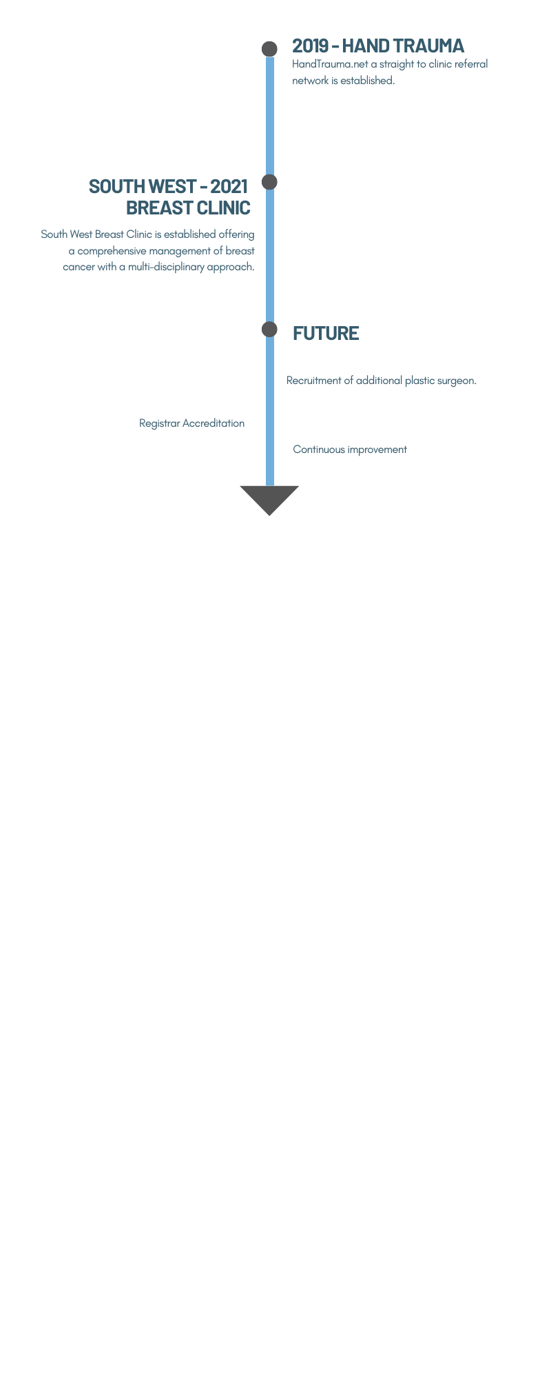
What’s Next for WPRS
Accredited registrar training: currently working with Southwest Healthcare in applying for a SET position in Warrnambool from 2024
Southwest Breast clinic: launched in 2021 to provide regional patients with greater access to comprehensive breast cancer management
Plastic surgeon recruitment Actively recruiting for additional Plastic and Reconstructive Surgeon to support flow of patients from outside primary catchment area
Engagement of additional healthcare networks Continue to work with public healthcare sector and have approached another regional hospital for theatre access
Notes:
HAMILTON
Over the past 5 years, we saw 1109 patients (7% of total) from Southern Grampians Shire
In 2022, we had a 65% increase in patients from Southern Grampians Shire on previous year 2021 (100 to 165) yet, denied theatre access.

Slide 24
Translating WPRS to other regional areas
Develop regional hubs: Identify regional hubs to implement hub and spoke model (alternatively outreach, FIFO)
Identify community needs: Examine community need and identify existing services and resources in place
Engage Healthcare networks: Develop relationship with public healthcare and tackle administrative barriers early (be prepared to educate decision makers on plastic and reconstructive surgery’s place in the community)
Integration: Integrate plastic and reconstructive surgery with other specialist and ancillary services to provide coordinated care

Slide 25
Translating WPRS to other regional areas
Regional registrars: Create training opportunities for registrars in regional areas
Private sector buy in: Seek buy-in from private sector (an often overlooked source of support when setting up a new service)
Research: Continue research into rural plastic and reconstructive surgery

Slide 26
The real key to translating WPRS to other regional areas
FUNDING

Slide 27
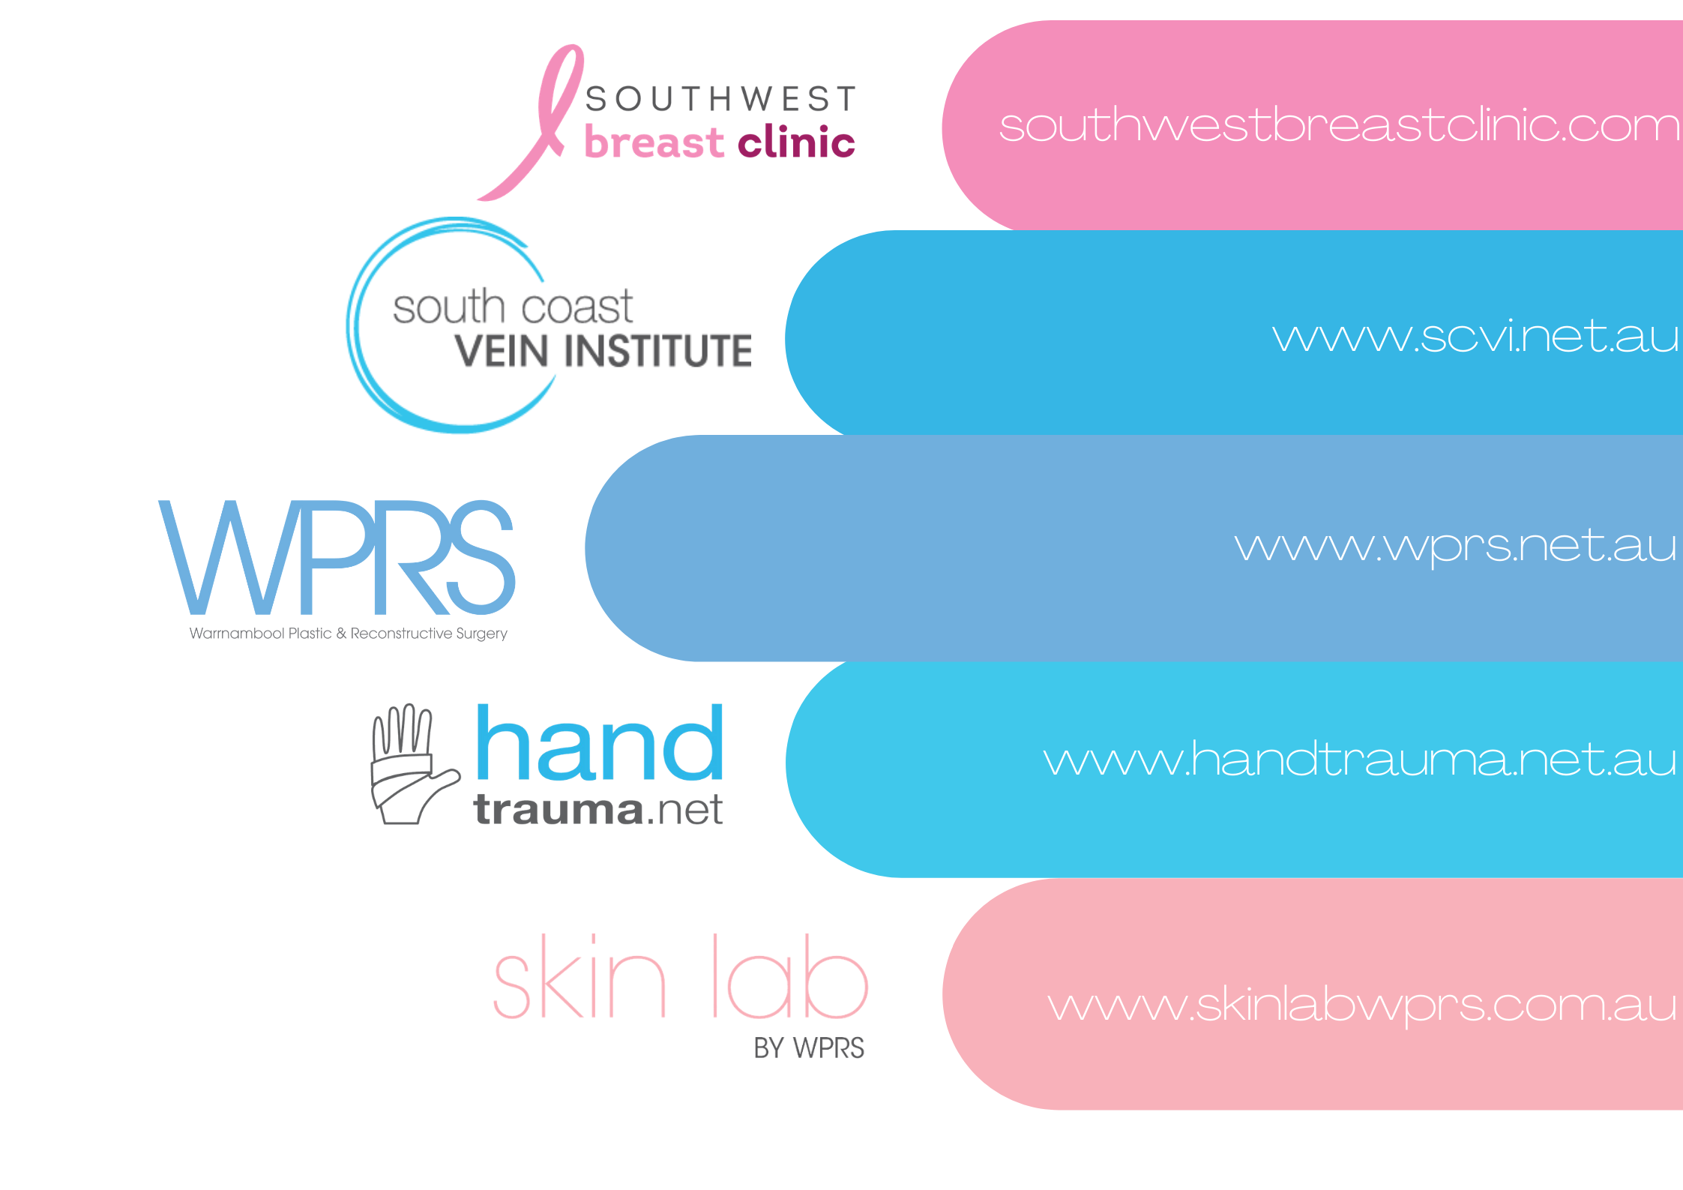
Warrnambool Plastic & Reconstructive Surgery

